Slide 1
Apple Vision Pro Project
Donovan Kohler, Trang Do, Anthony Rutherford, Sam Kwon, Raudel Armenta

Slide 2
General Motivation
For use in university research
Allow for communication between devices
Facilitate usage of Apple Vision Pro to collect and process data
Ability to explore human robot collaboration
Connect other robots to Apple Vision Pro
Notes:
Send information between Apple Vision Pro and server for information processing or use of AI models
Distributed intelligence
Client-server architecture

Slide 3
General Motivation
Targeted User: Research participants
  Student
  Faculty
  Robotics engineers, Robotics technicians
Notes:
Send information between Apple Vision Pro and server for information processing or use of AI models
Distributed intelligence
Client-server architecture

Slide 4
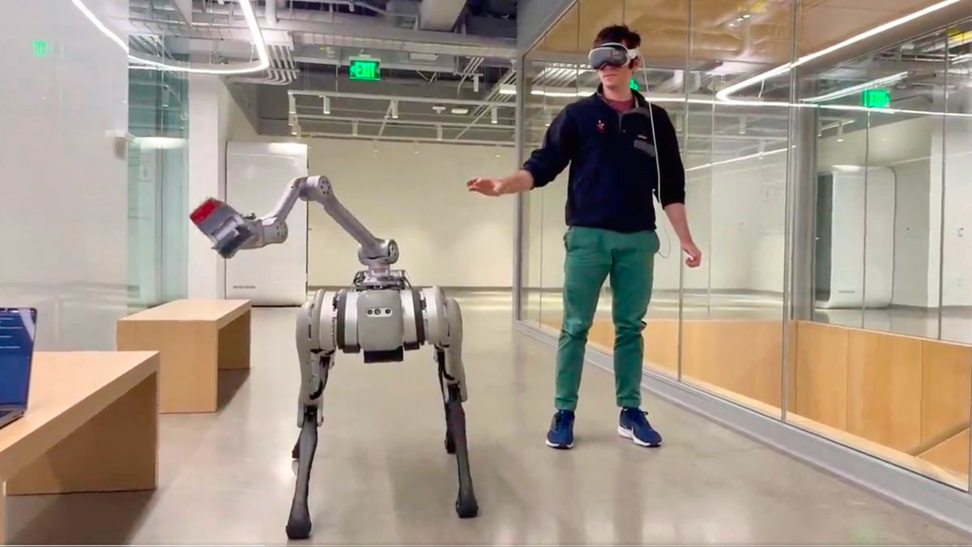
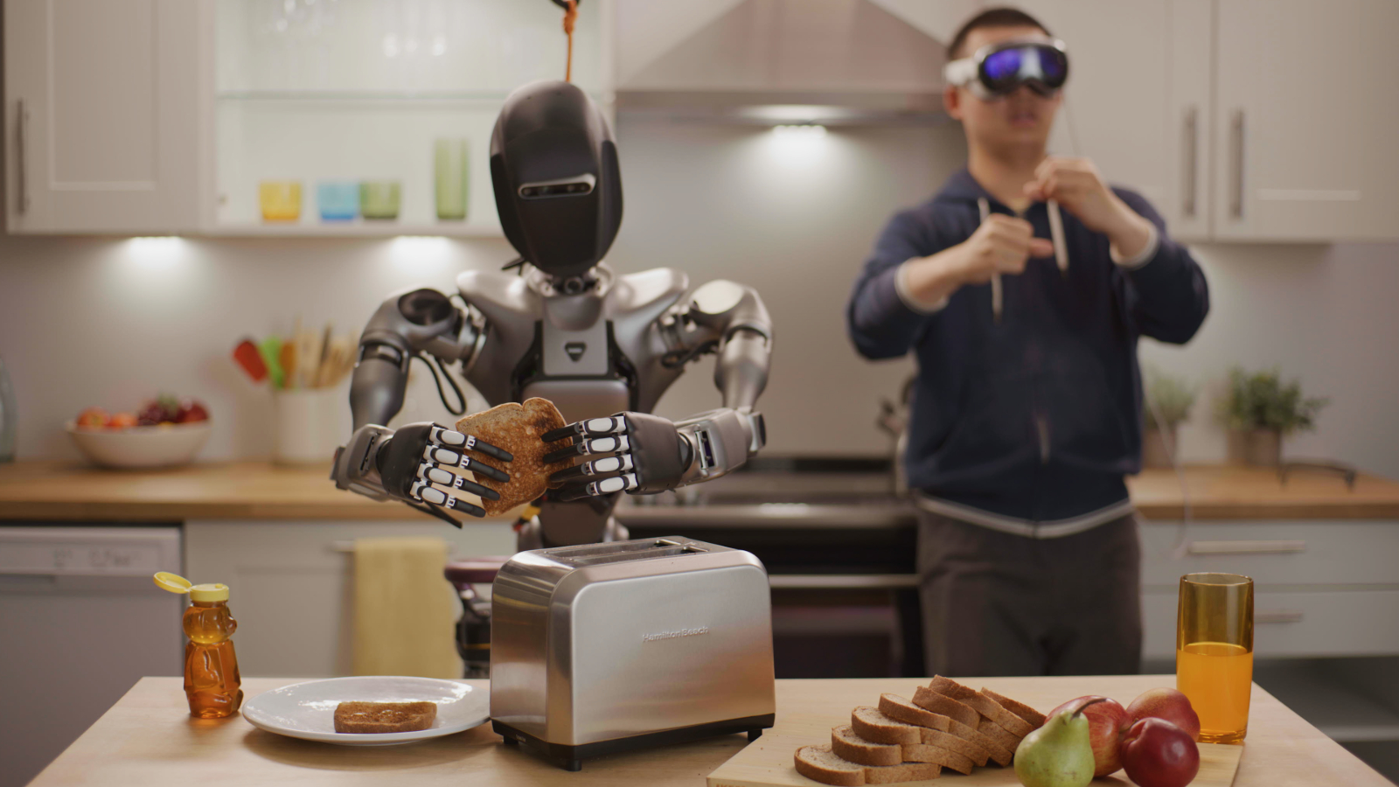
Notes:
Send information between Apple Vision Pro and server for information processing or use of AI models
Distributed intelligence
Client-server architecture

Slide 5

Core Features
Distributed intelligence (client – server architecture)
  Send data between headset and server
Server-side processing components
  Use ML models
    Image recognition
    3D space
Notes:
Send information between Apple Vision Pro and server for information processing or use of AI models
Distributed intelligence
Client-server architecture

Slide 6
Technical Details
Possible Tech
  Apple Vision Pro
  MacBook
  VS Code
Possible APIs
  Core ML --> ML Preprocessing
  ARKit --> RESTful APIs
  CryptoKit --> Data encryption
  Gzip --> Data compression
  RealityKit --> Visual rendering

Slide 7
Development Environment
Server-side:
  VS Code
    Python / Jupyter Notebooks
    Hugging Face Models
  AWS Cloud9
    For working directly in cloud environment
Apple Vision Pro:
  Xcode
    VisionOS SDK
    Vision Pro Simulator for testing

Slide 8
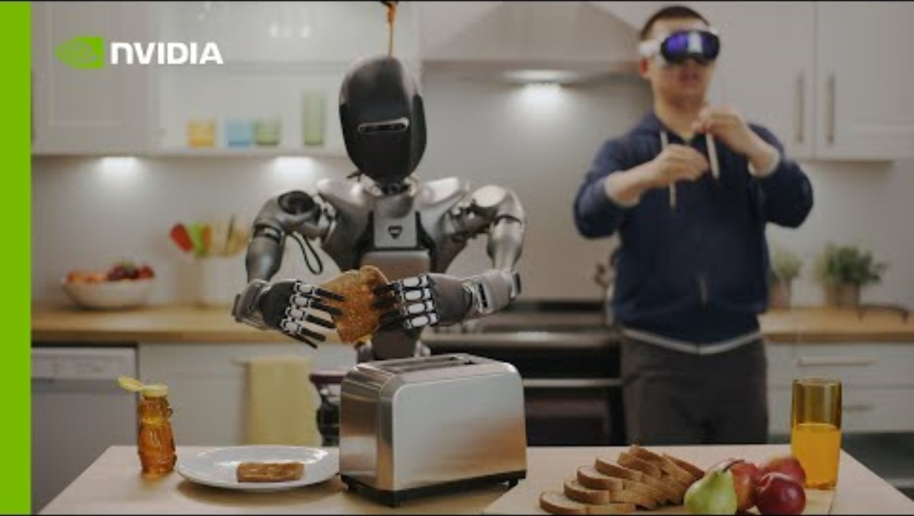
Similar Apps

Slide 9
Initial Challenges
Setting up Development Environment
Learning Curve for visionOS Development
  visionOS APIs (RealityKit, ARKit, and VisionKit)
Using Machine Learning models on Hugging Face

Slide 10
Initial Challenges
Converting collected data from Vision Pro to model-compatible inputs for data processing
Building skills in Machine Learning, Computer Vision, AR/VR Development

Slide 11
Thank you!

